Slide 1
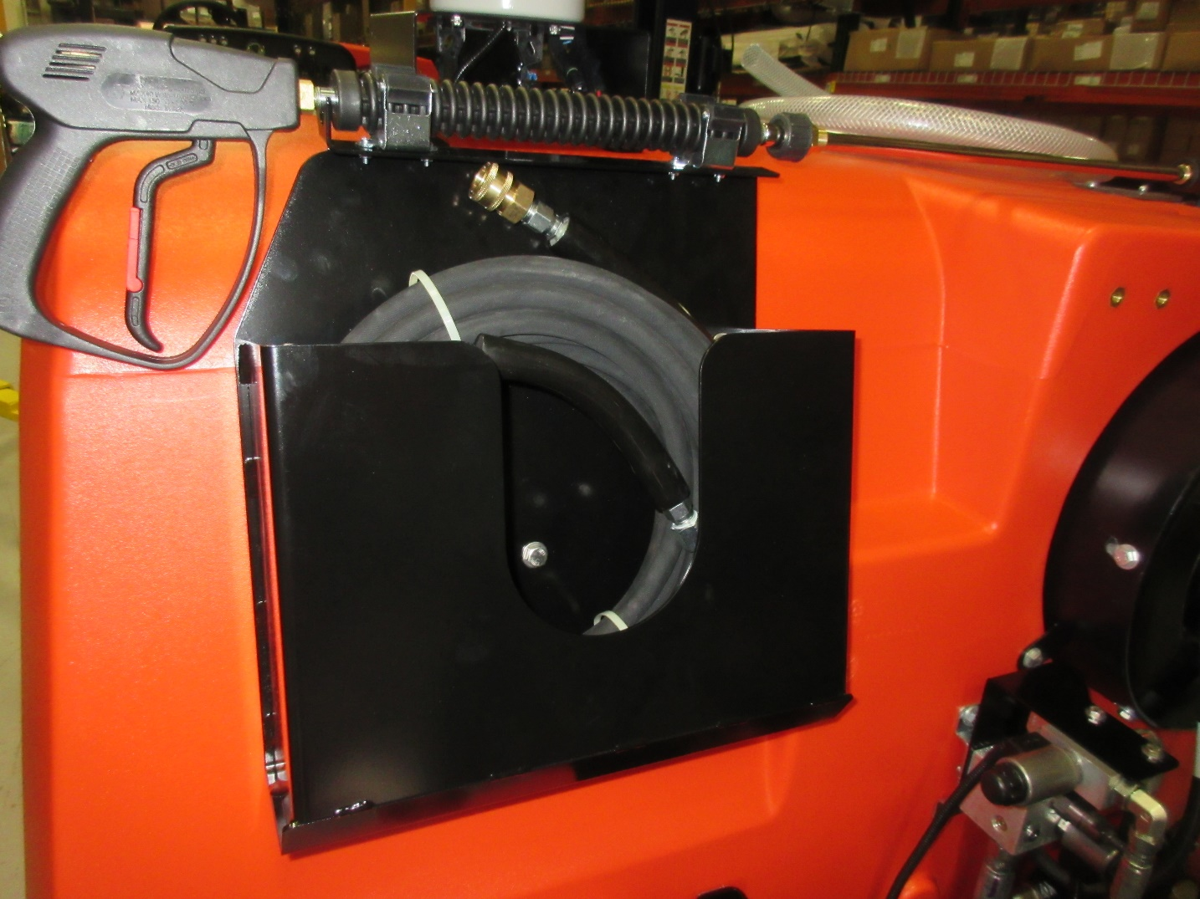
The following pages show the steps to assemble the 730041 Pressure Washer Option for the Nautilus.
Pages 1 - 33

Slide 2
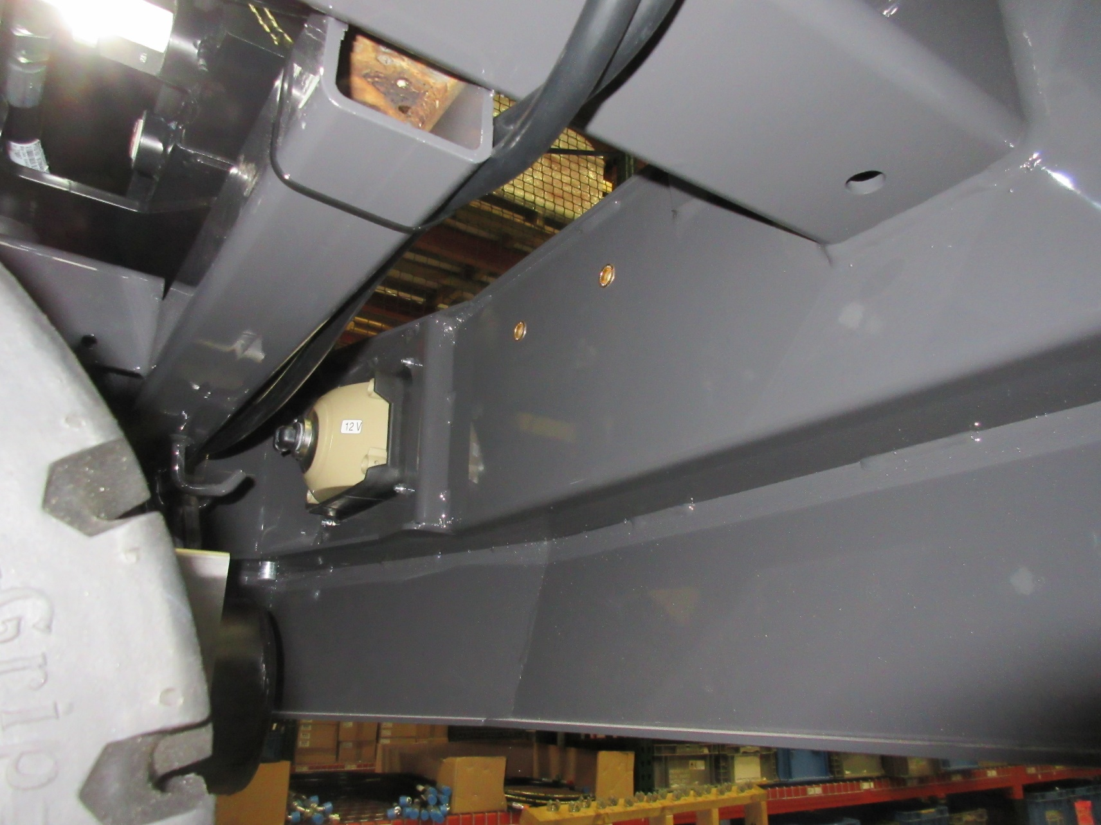
600852
Locate (2) 600852 Inserts that have been preinstalled into the frame near the headlights.

Slide 3
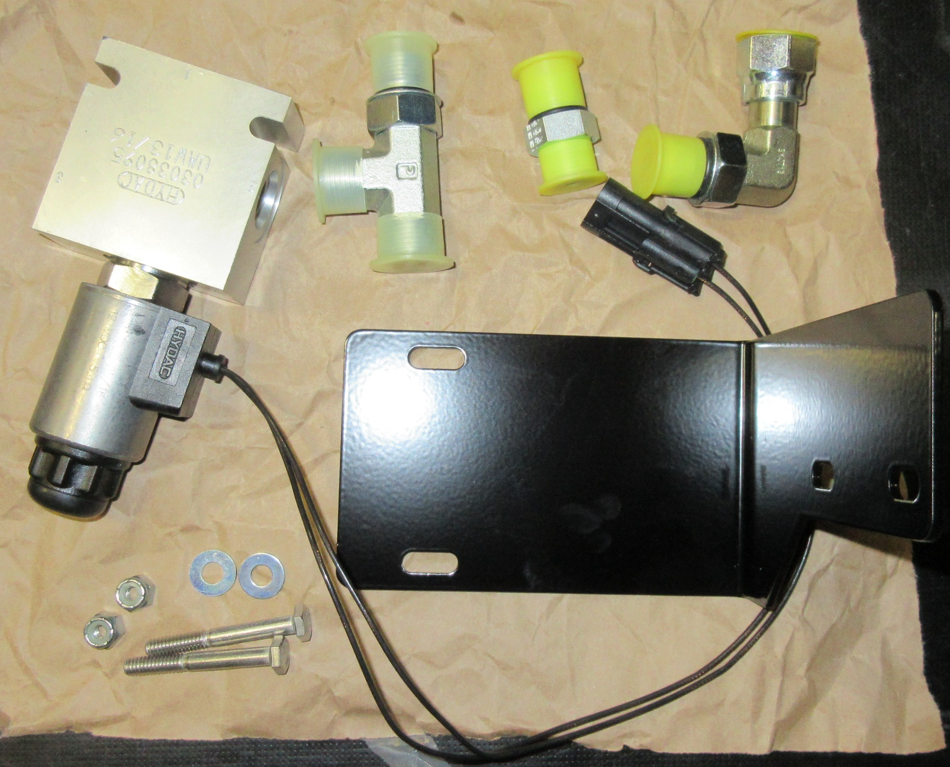
Port 1
675521
675628
Port 2
675525
731292
Port 3
731431
3400089
711373
712567
Page 1 of 5 – Remaining parts needed to finish the installation of the Pressure Washer option.

Slide 4
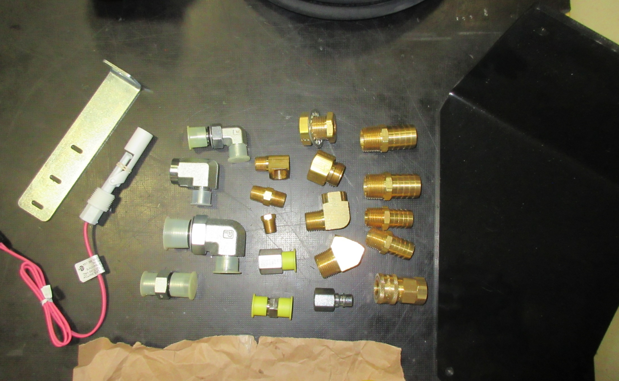
3320551
731460
675520
731425
731455
3339916
675537
675635
731422
3400689
731441
675524
731442
Page 2 of 5 – Remaining parts needed to finish the installation of the Pressure Washer option.

Slide 5
3302737-1
731423
731449
3320728
675634
281093
731424
Page 3 of 5 – Remaining parts needed to finish the installation of the Pressure Washer option.

Slide 6
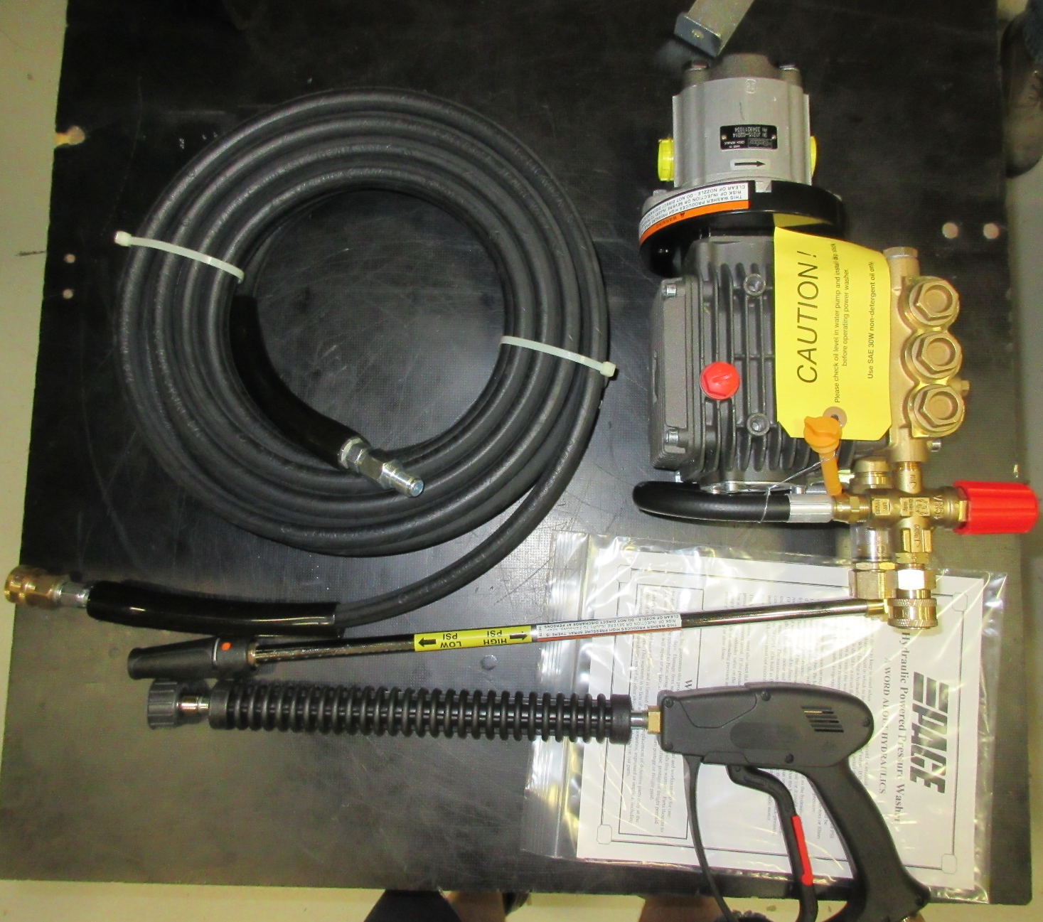
731413
731440
731442
731447
731446
731445
Page 4 of 5 – Remaining parts needed to finish the installation of the Pressure Washer option.
731444
NOTE: Swap existing fitting on the hose with (1) 731442 fitting.

Slide 7
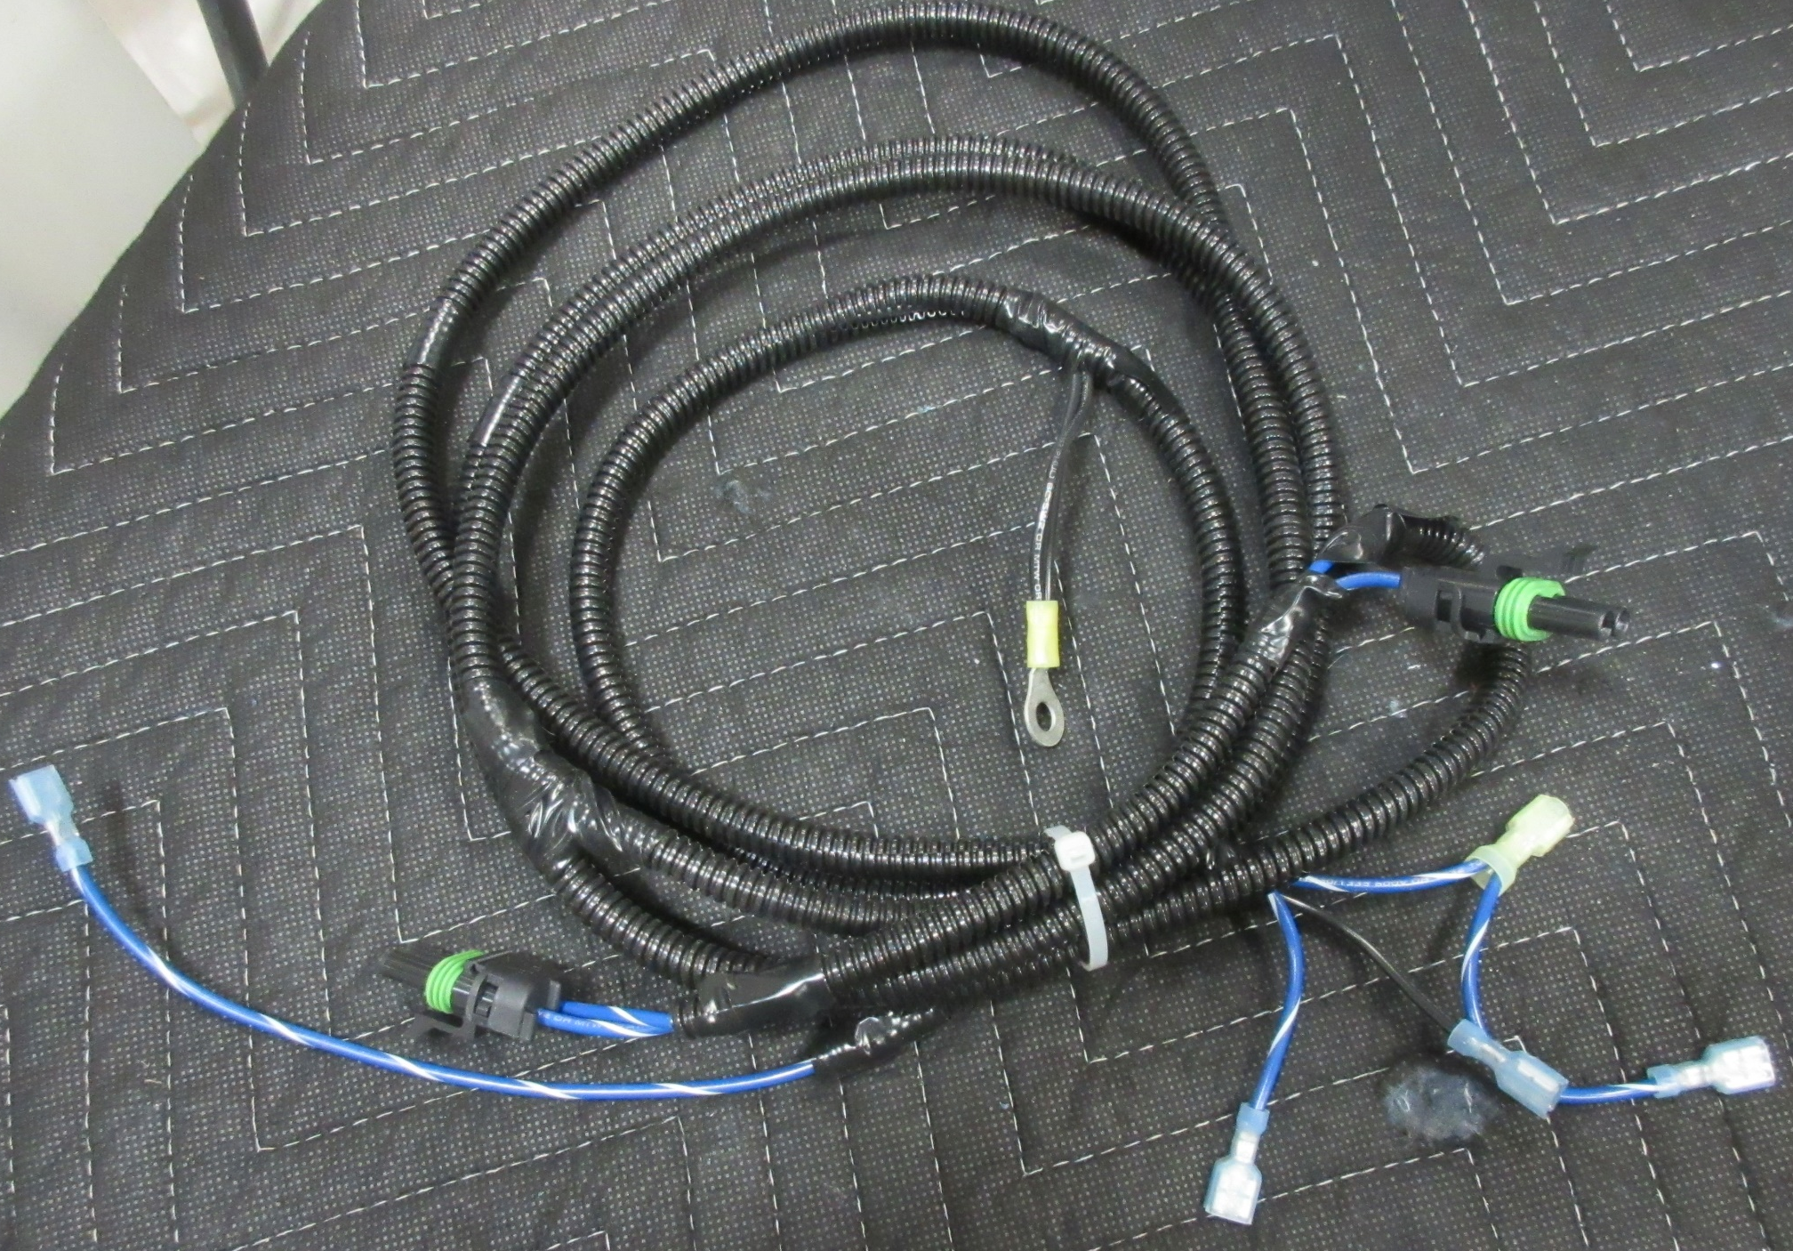
748735
Page 5 of 5 – Remaining parts needed to finish the installation of the Pressure Washer option.

Slide 8
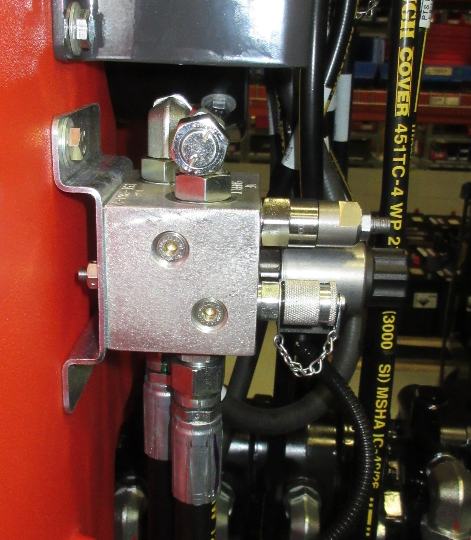
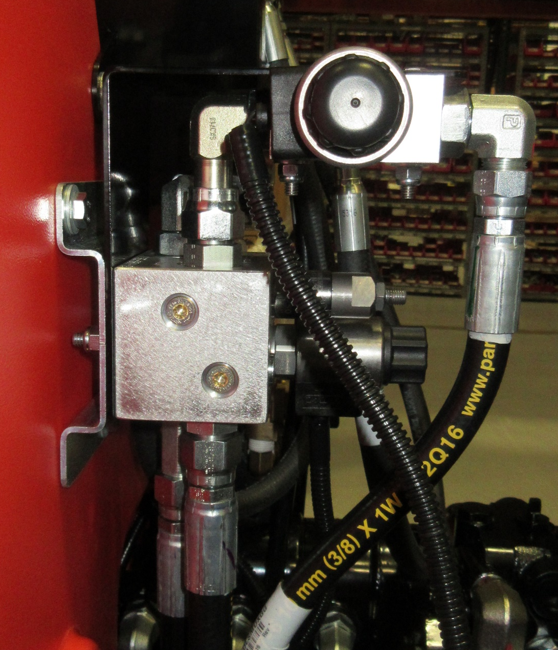
731431
Mount the 731431 Mount between the Impeller Manifold and the Impeller Manifold Mount.

Slide 9
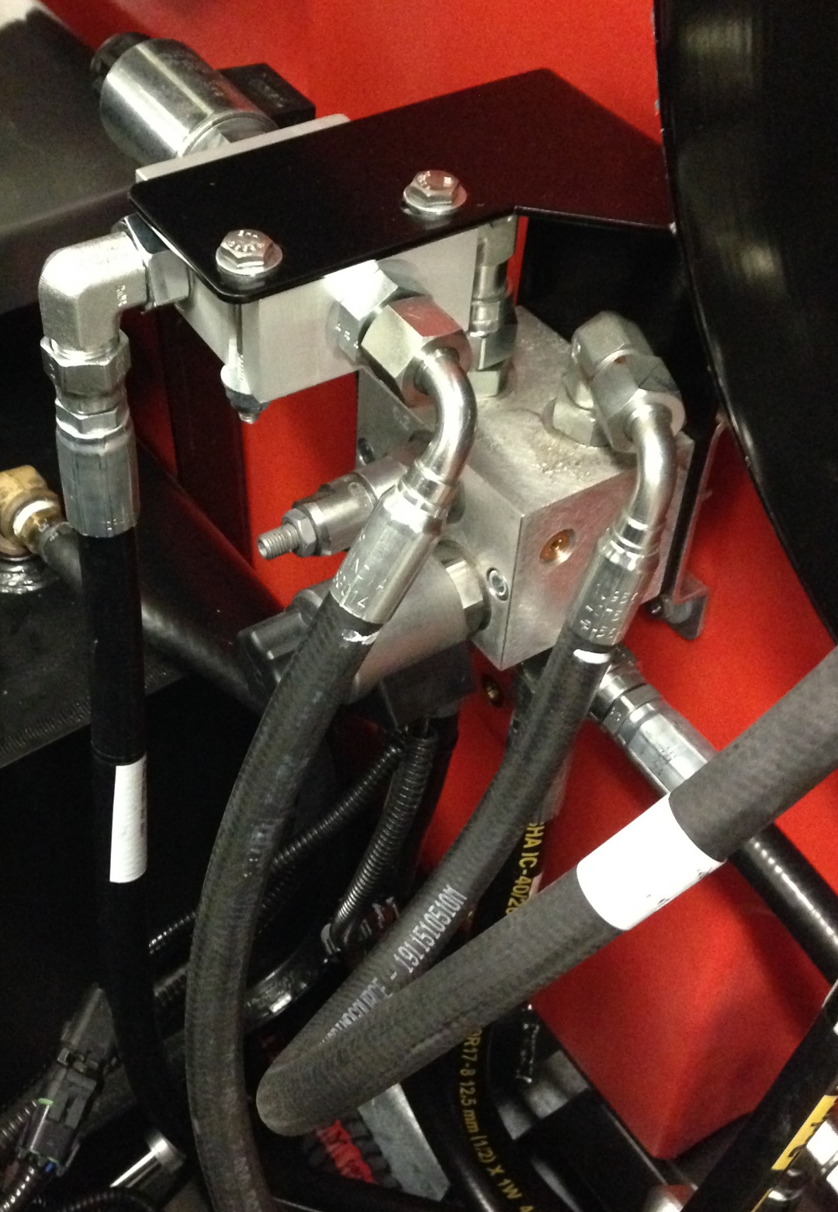
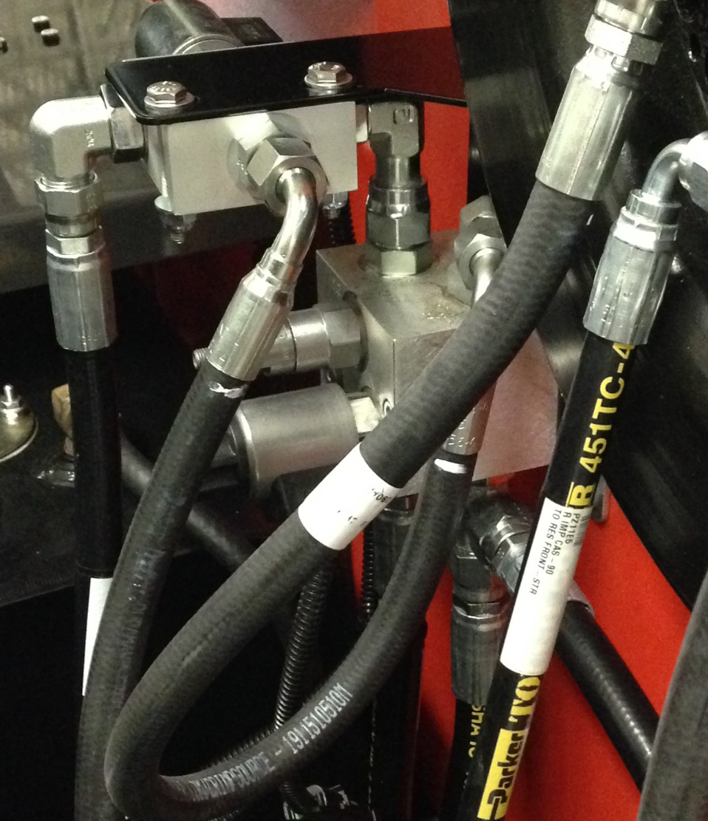
731292
712567, 3400089, 711373
675628
Port 3
Port 2
731431
675520
675521
Port 1
Install (1) 675628 FTG, (1) 675520 FTG, and (1) 675521 FTG into (1) 731292 Valve.
Mount 731292 Valve onto (1) 731431 Mount.
Use (2) 712567 Bolts, (2) 3400089 Washers, and (2) 711373 Nuts.

Slide 10
731292
675628
675524
731431
675520
675525
Install (1) 675520 FTG, (1) 675524 FTG, and (1) 675525 FTG onto the Impeller Manifold.
Connect the 675628 FTG on the 731292 Valve to the 675524 FTG on the Impeller Manifold.

Slide 11

731452
731062
731061
731453
731057

Slide 12
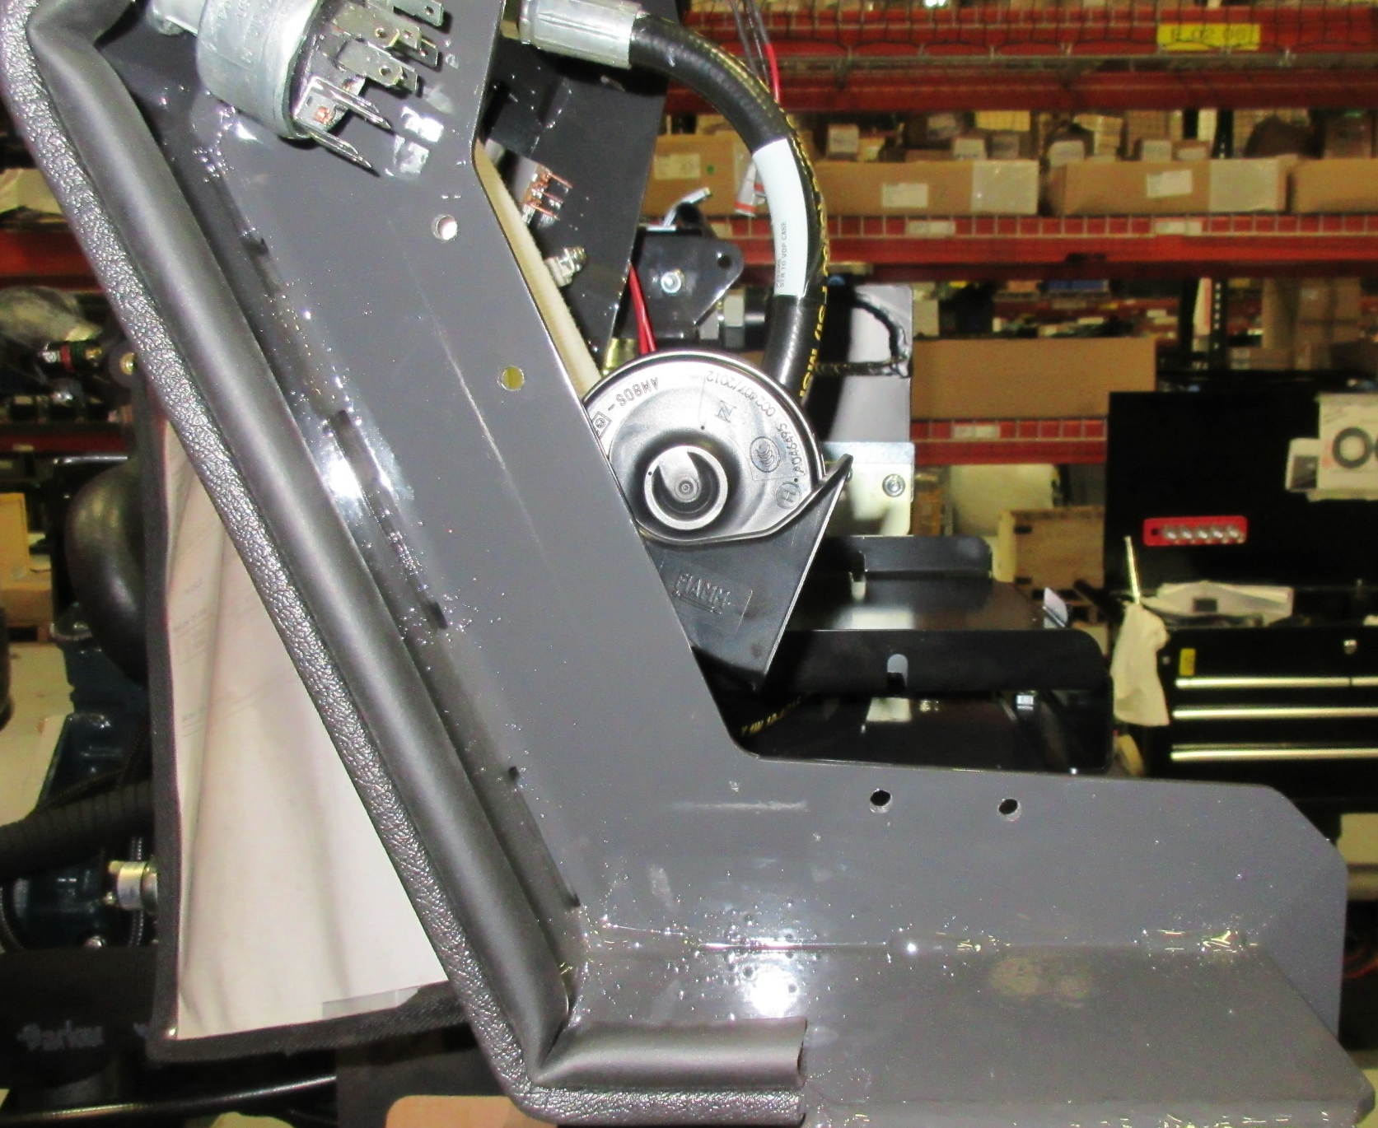
1-3/4”
7/16”
6-11/16”
1-1/2”
3/8”
4”
Drill 4 (1/4”) holes using the measurements indicated above.

Slide 13
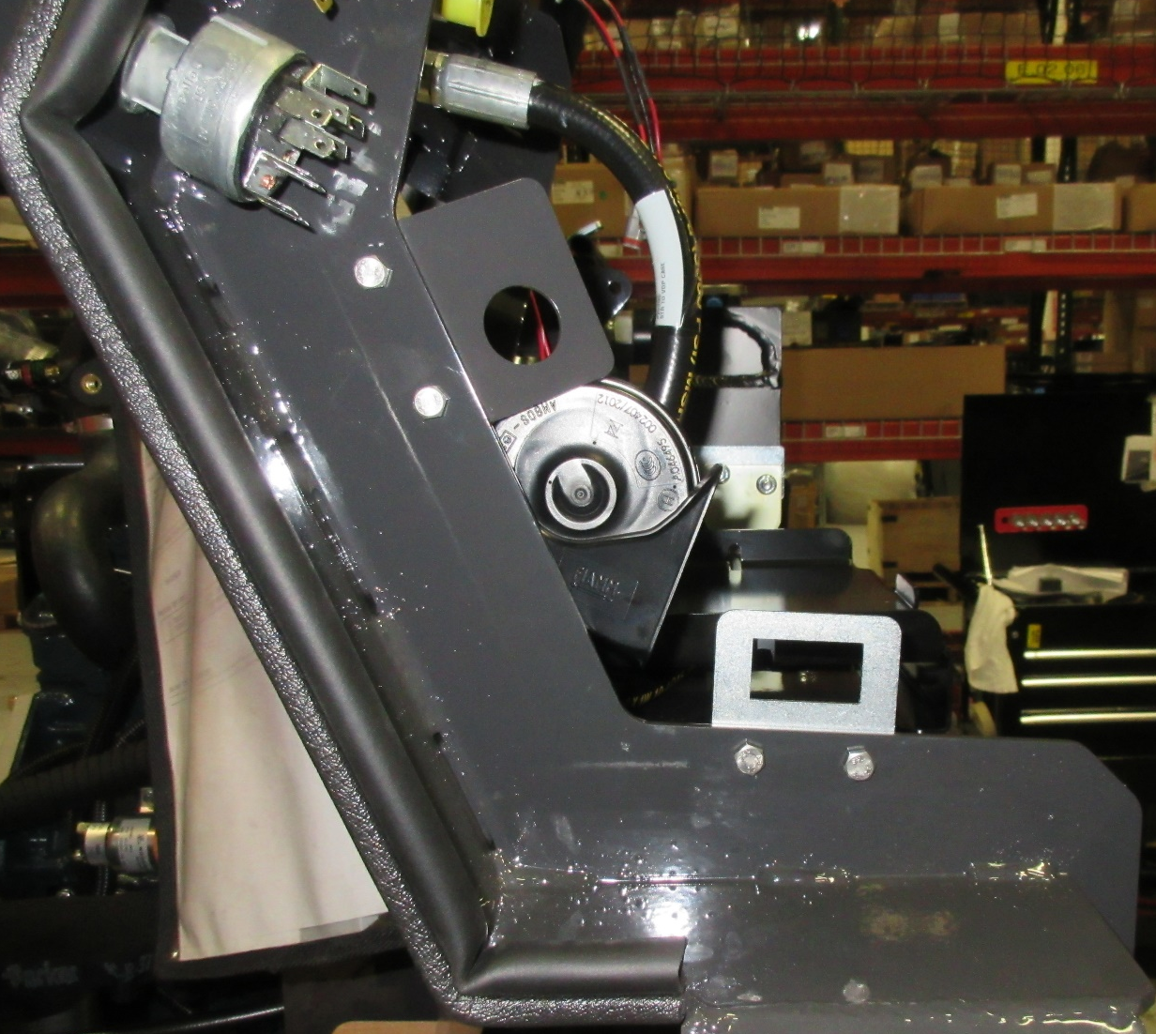
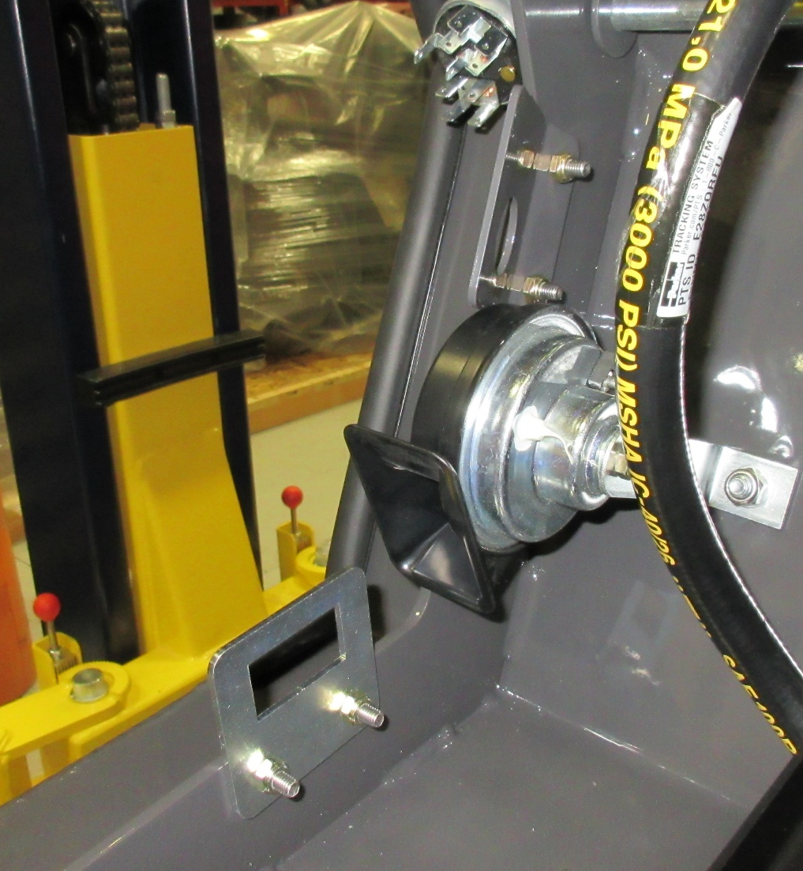
731436
731459
600913, 12040044
Install (1) 731436 Mount, and (1) 731459 Mount.
Use (4) 600913 Bolts, and (4) 12040044 Nuts.

Slide 14
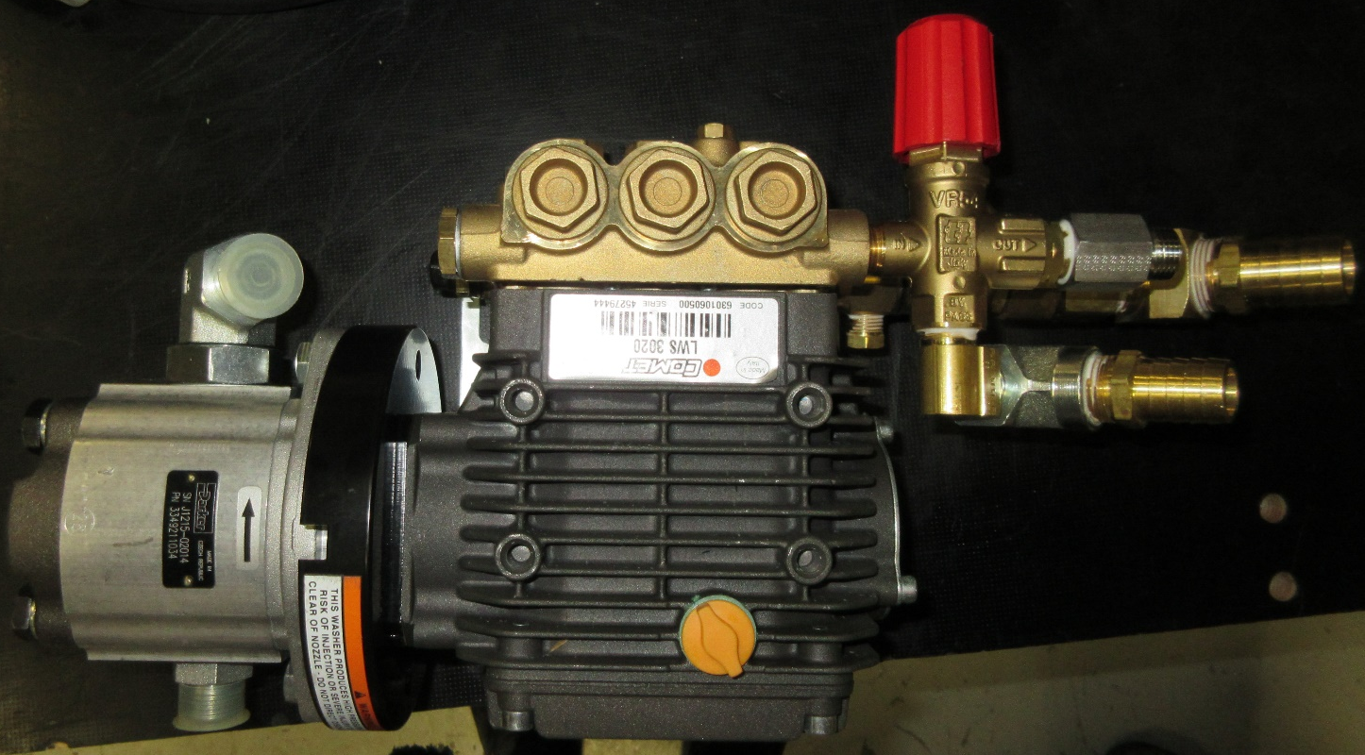
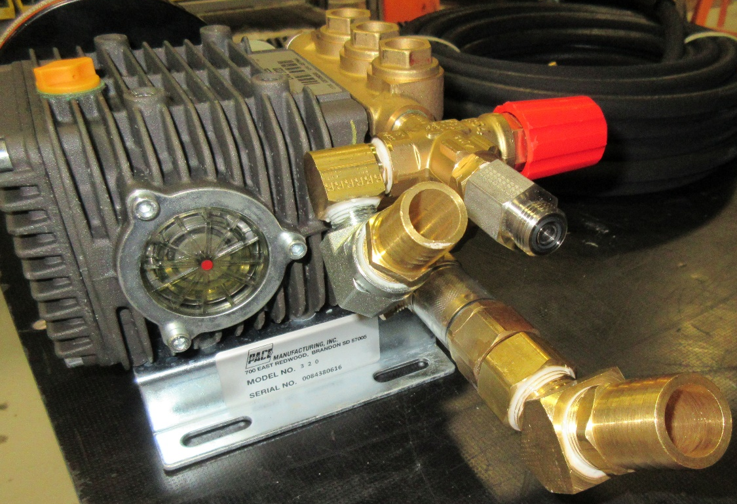
NOTE: When installing 675635 fitting be careful not to loosen the pre-existing brass fitting.
675537
675635
3320551
3400689
Install (1) 675537 FTG, and (1) 3400689 FTG; (1) 675635 FTG; (1) 3320551 FTG, (1) 3339916 FTG, (1) 3320728 Hose Barb; (1) 731455 Adapter, (1) 731424 FTG, and (1) 731423 Hose Barb into the 731413 Pressure Washer.
Apply Loctite to the threads of fittings to prevents leaks.
731455
3339916
3320728
731424
731423

Slide 15
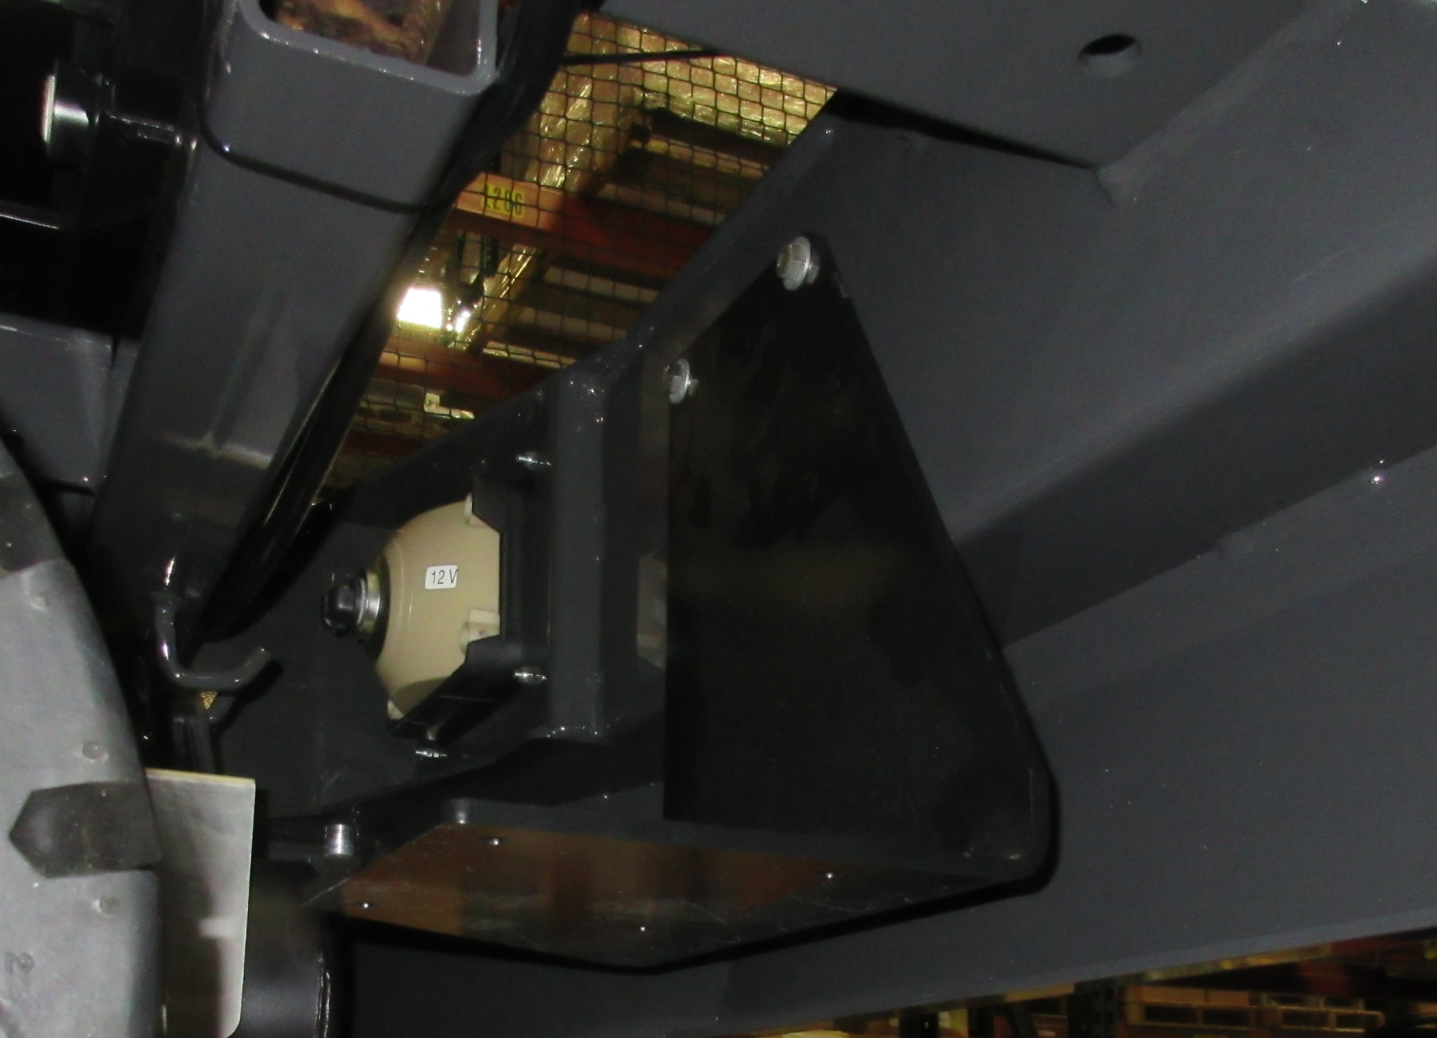
11039567, 3400384
730967
731422
Place (1) 730967 Pad between the 731422 Mount and the Frame.
Install (1) 731422 Mount onto the Frame.
Use (2) 11039567 Bolts, and (2) 3400384 Washers.

Slide 16
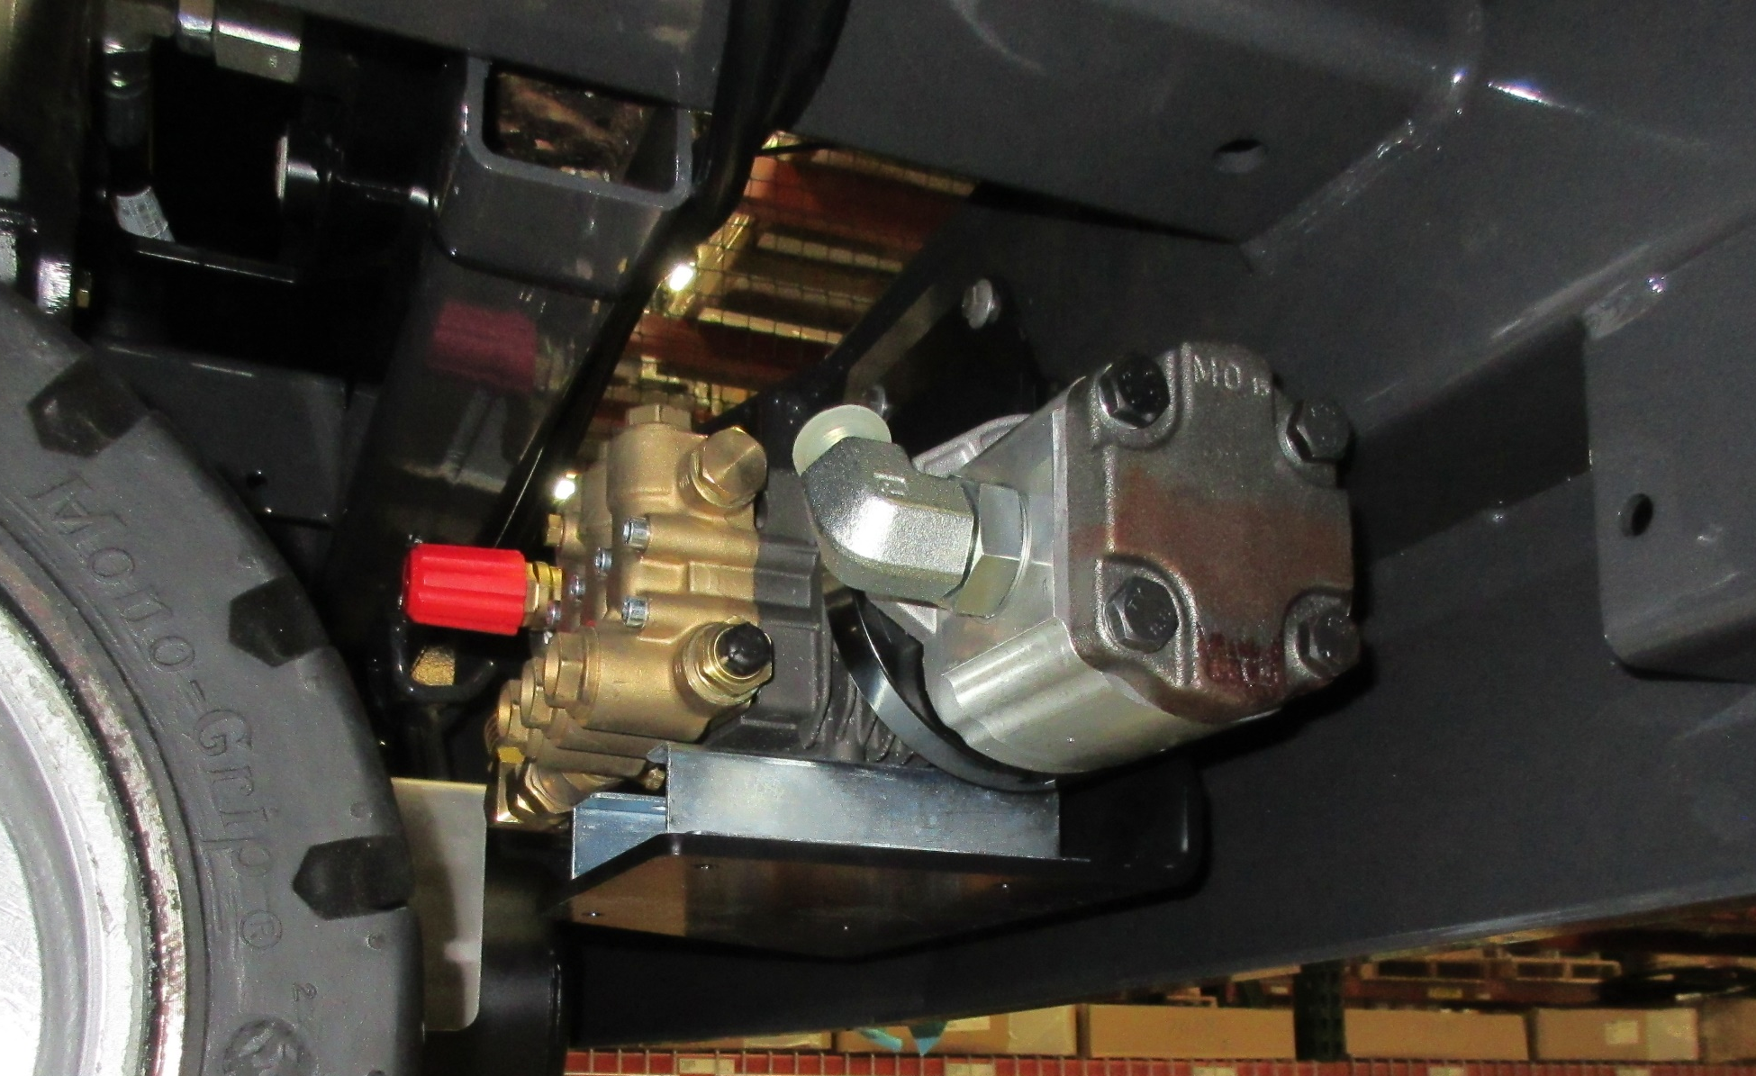
717030, 3400384, 600934
Install 731413 Pressure Washer onto 731422 Mount.
Use (4) 717030 Bolts, (4) 3400384 Washers, and (4) 600934 Nuts.

Slide 17
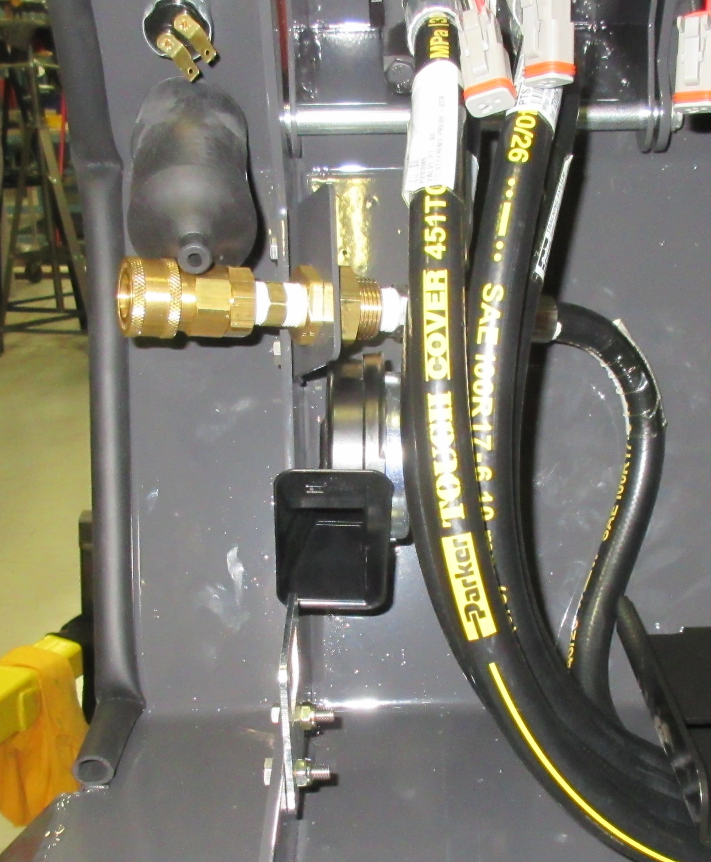
731436
731449
731454
Assemble (1) 731441 Quick Disconnect Coupler, (1) 731449 FTG, (1) 731425 Anchor Coupling, and (1) 675634 FTG.
Mount the previously assembled parts onto the 731436 Quick Disconnect Mount.
Use the nut provided with the 731425 Anchor Coupling.
731441
731425
675634

Slide 18
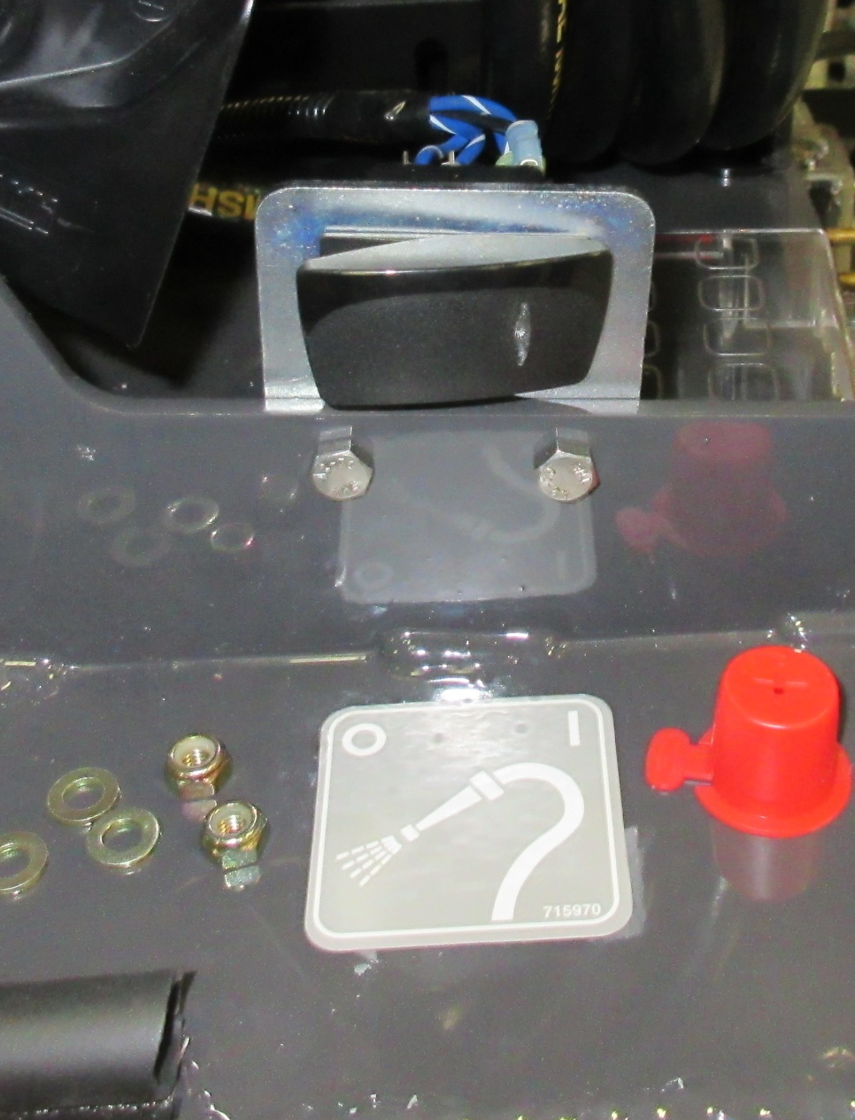
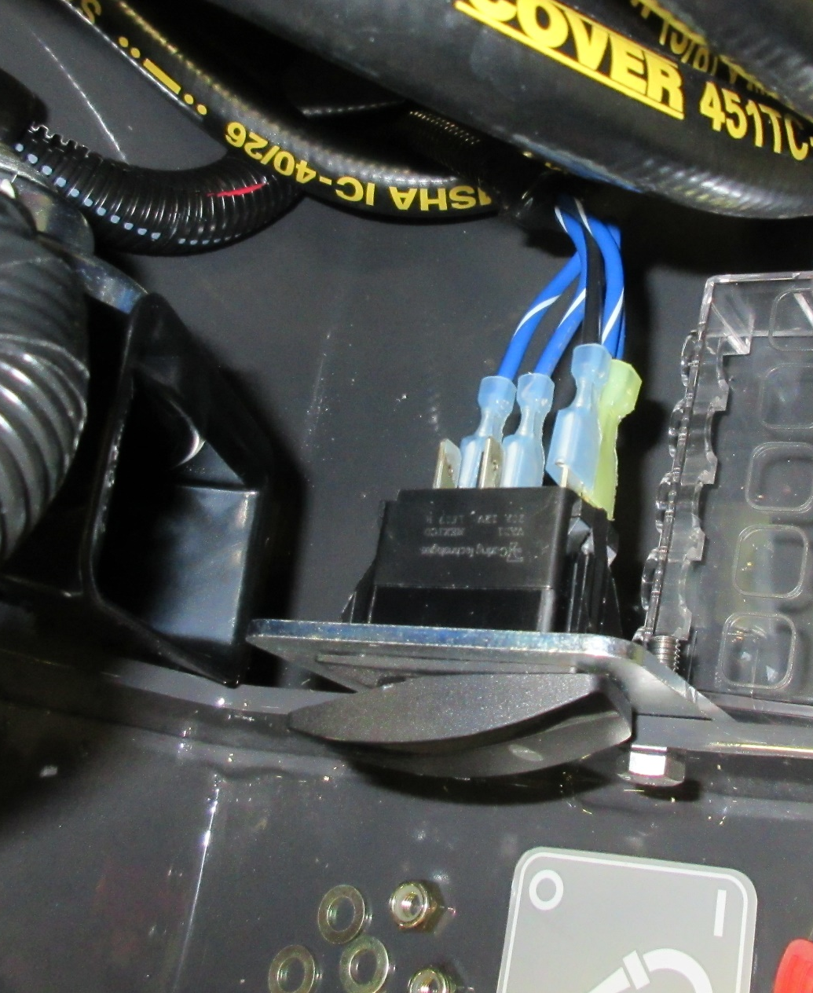
731459
620137
3342273
715970
Install (1) 620137 Switch Body and (1) 3342273 Switch Cover into 731459 Switch Bracket.
Install (1) 715030 Wash Switch Decal.

Slide 19
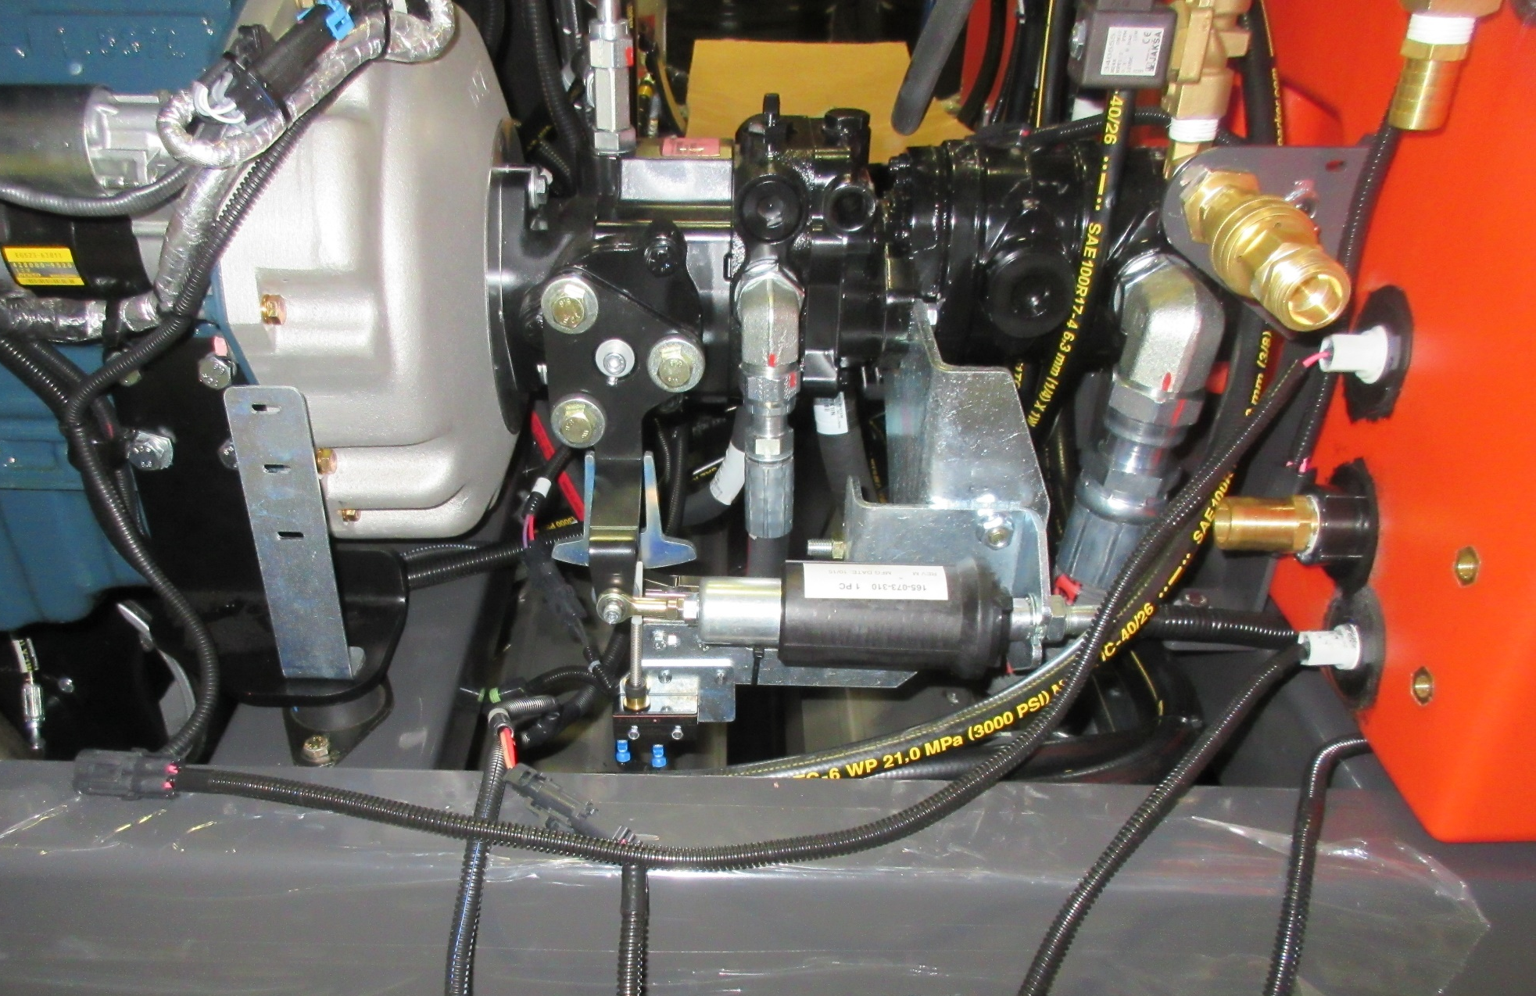
3302737-1
Install (1) 3302737-1 Float Switch into the solution tank.
NOTE: Orient the 3302737-1 Float Switch in the “Normally Closed” Position. (Tab Facing Down)

Slide 20
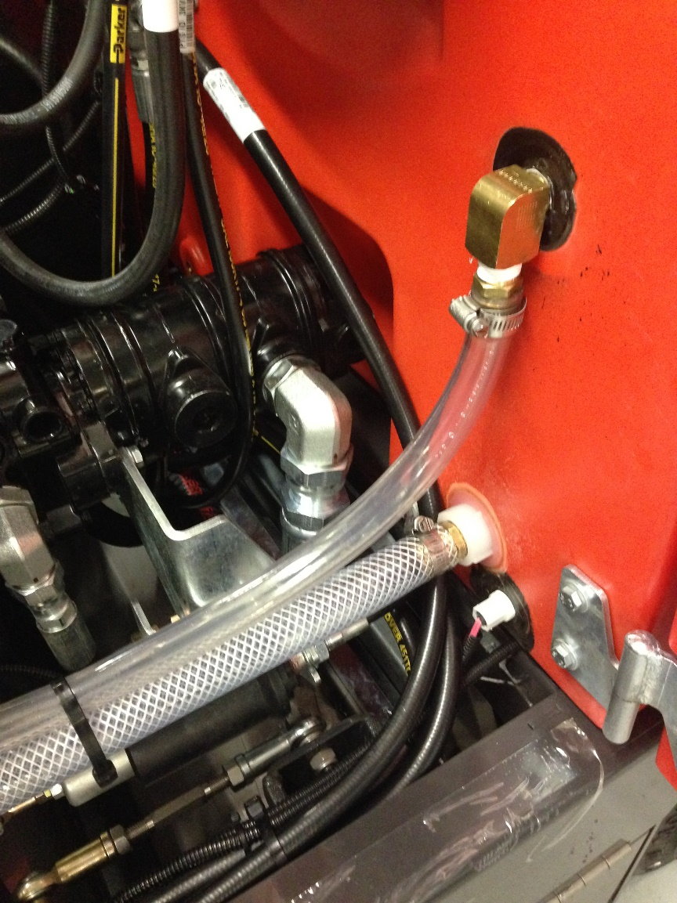
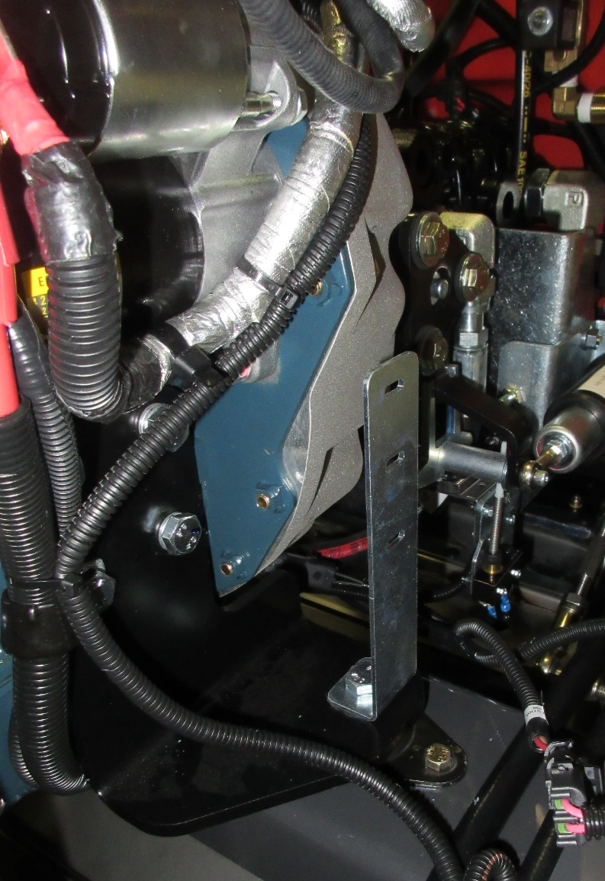
281093
731423
731460
3320726
Install (1) 731460 Clamp Bracket onto the frame.
Use existing hardware on the motor mount to mount the bracket.
Install (1) 281093 FTG, (1) 731423 Hose Barb; (1) 3320726 Hose Barb into the Solution Tank.

Slide 21
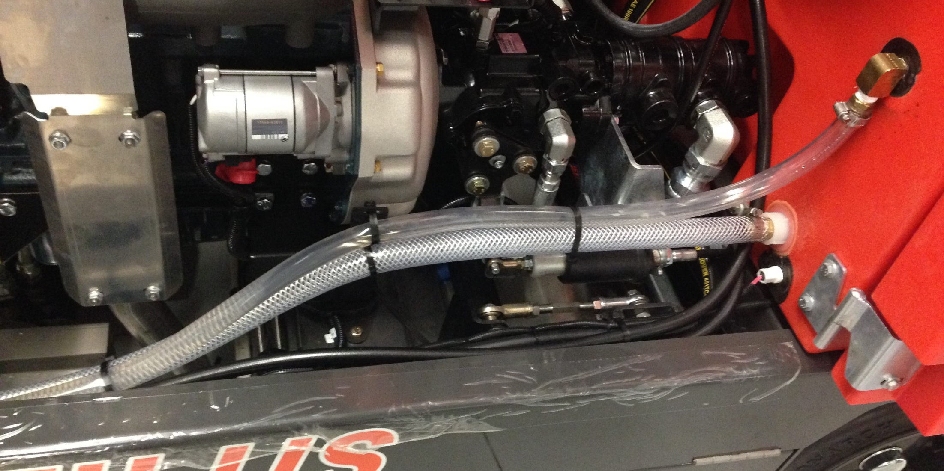
3300535
828062-B
731461
3302193
731456
Install (1) 731461 Hose and (1) 731456 Hose.
Use (1) 3302193 Hose Clamp, (1) 3300535 Hose Clamp, and (4) 828062-B Wire Ties.

Slide 22
731461
731456
Hose Routing Page 1 of 3
NOTE: Ensure that the water hoses are routed and secured away from the exhaust.

Slide 23
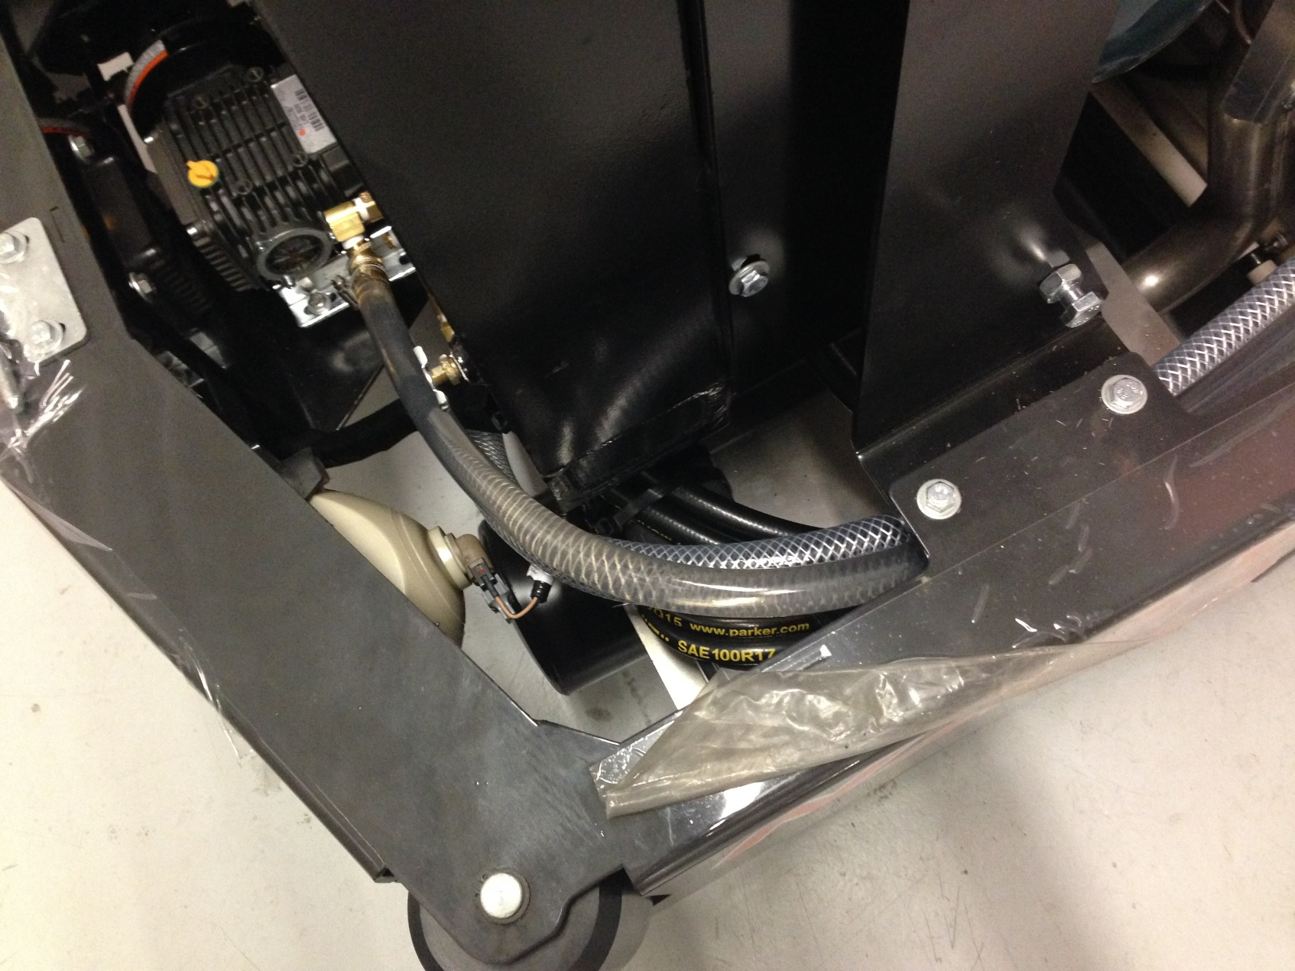
731456
731461
Hose Routing Page 2 of 3
NOTE: Ensure the water hoses are routed away from the radiator.

Slide 24
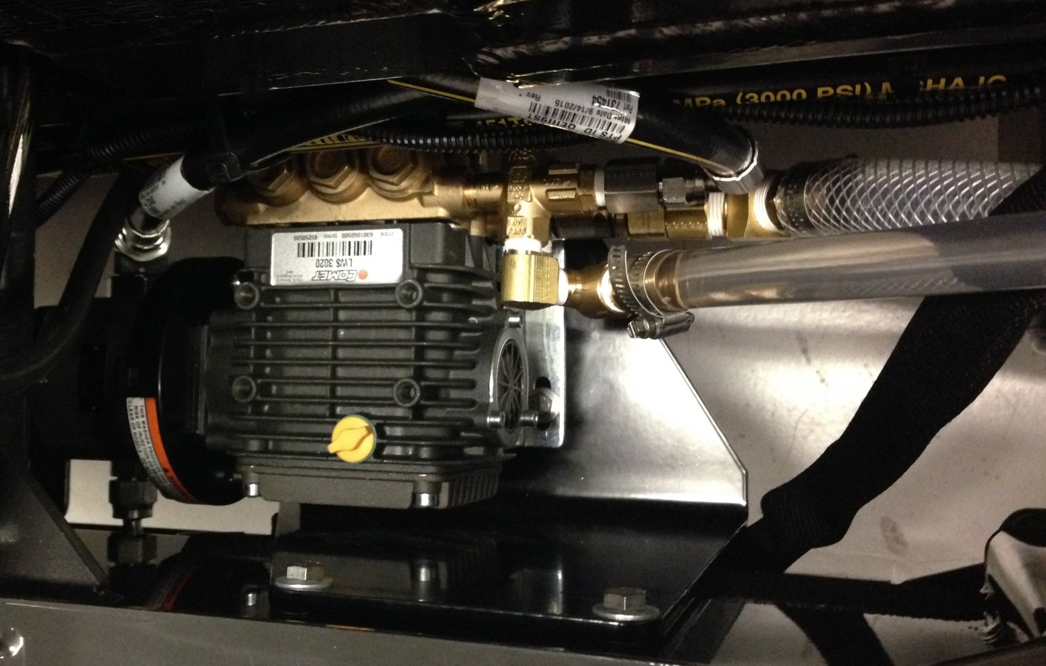
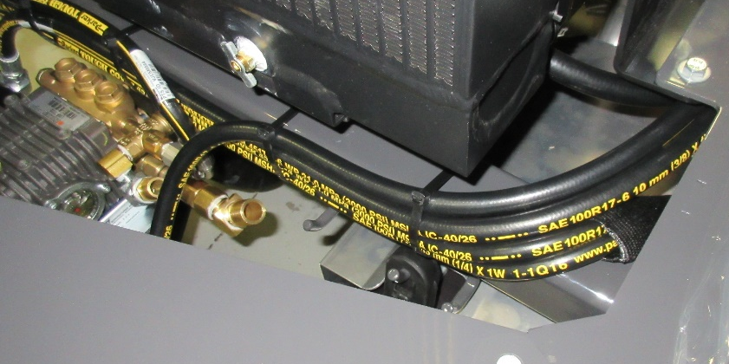
731454
731456
731452
731461
3300535
3302193
731431
Hose Routing Page 3 of 3
Secure the 731456 Hose to the Pump using (1) 3302193 Hose Clamp.
Secure the 731461 Hose to the Pump using (1) 3300535 Hose Clamp.

Slide 25
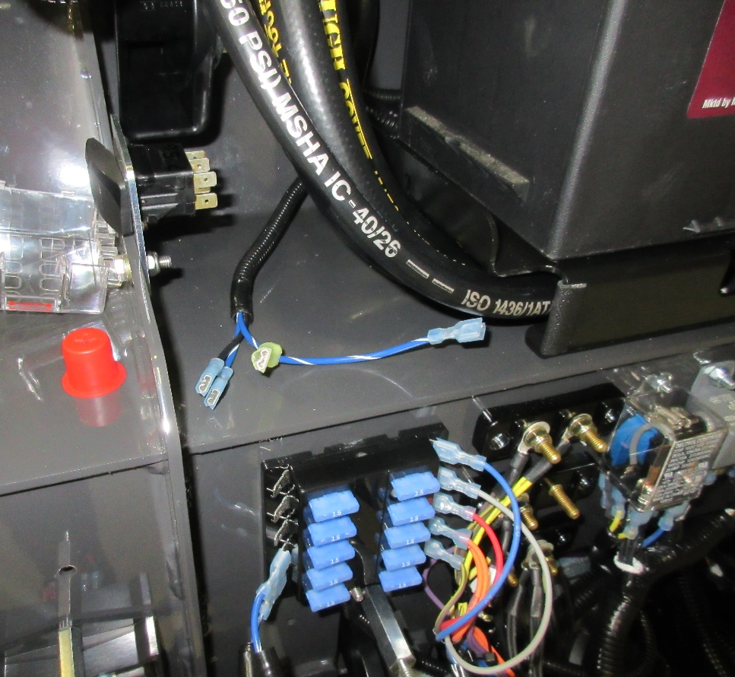
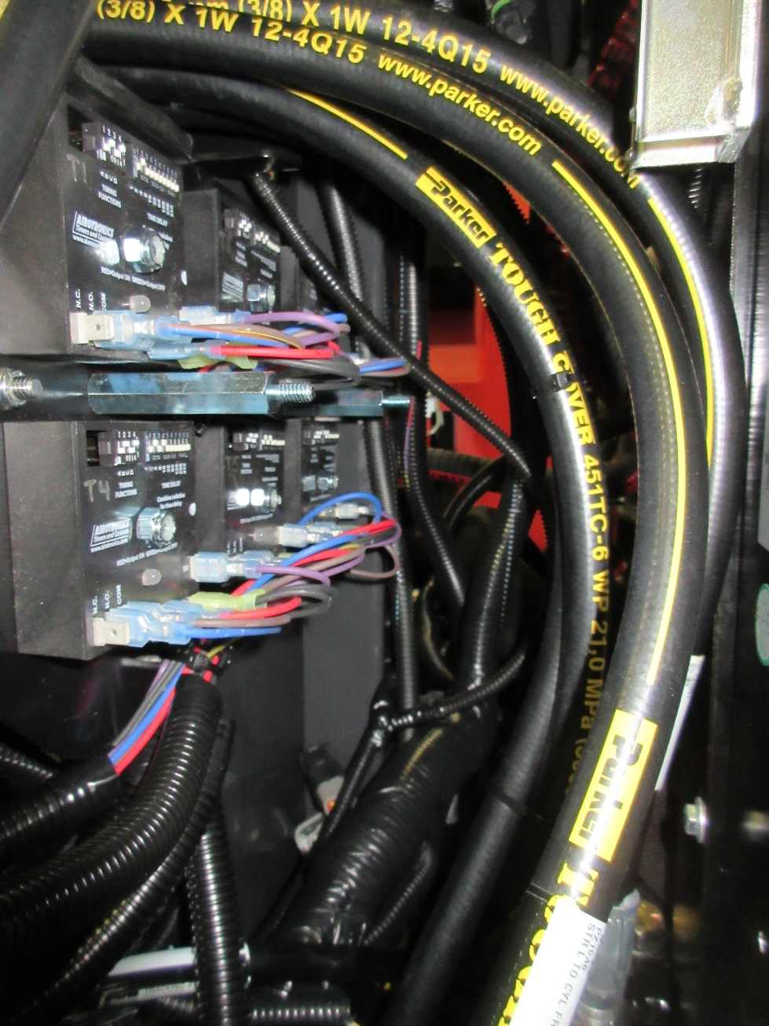
748735
Route the 748735 Wiring Harness in the machine as shown on this and the following pages.

Slide 26
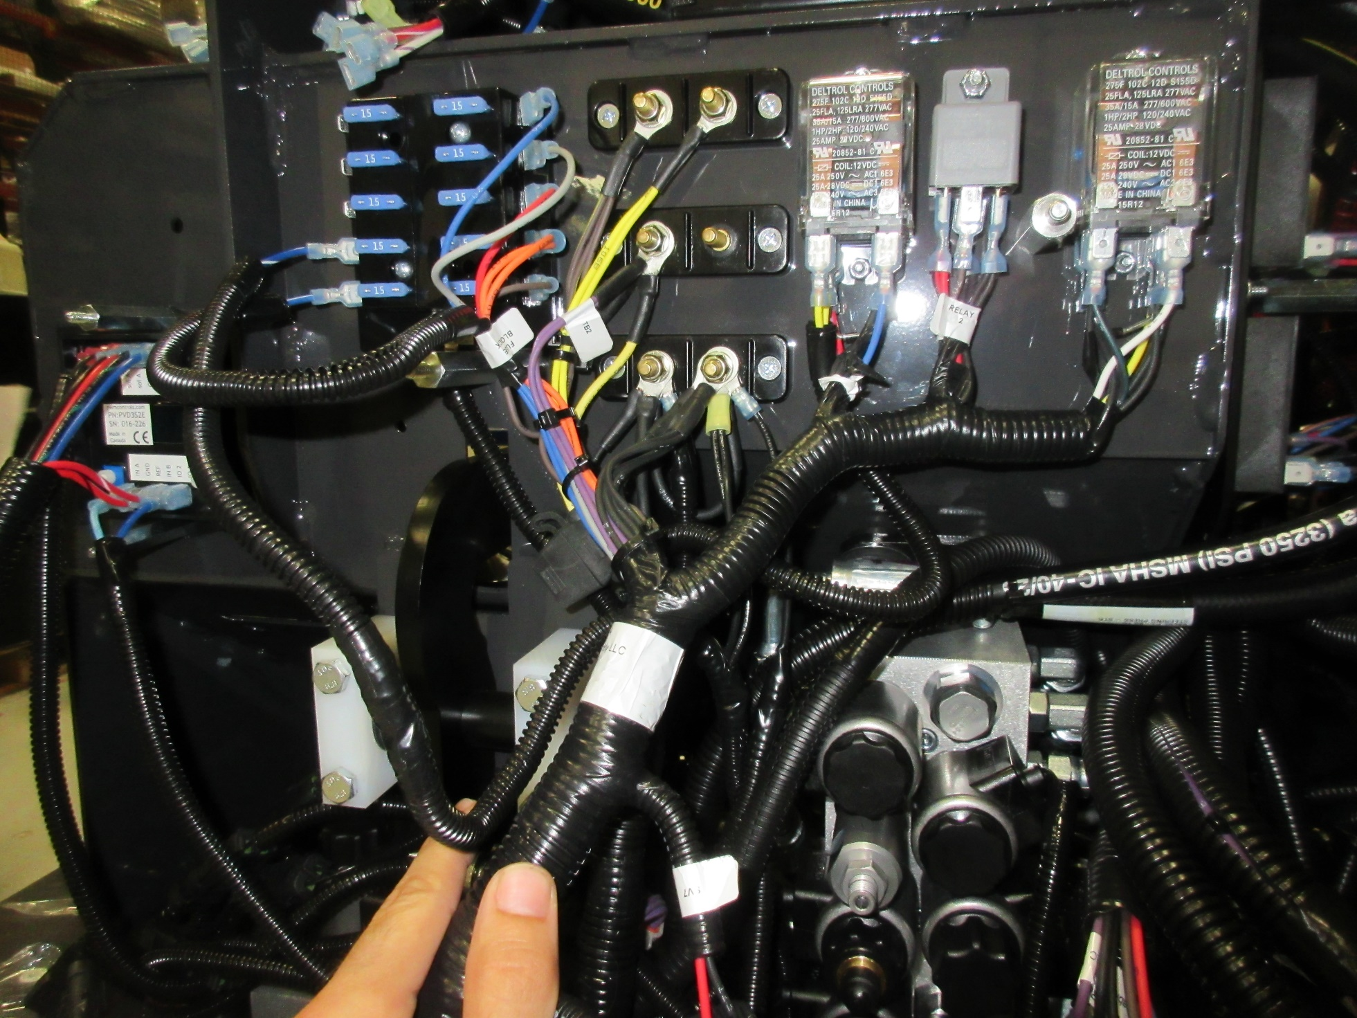

Slide 27
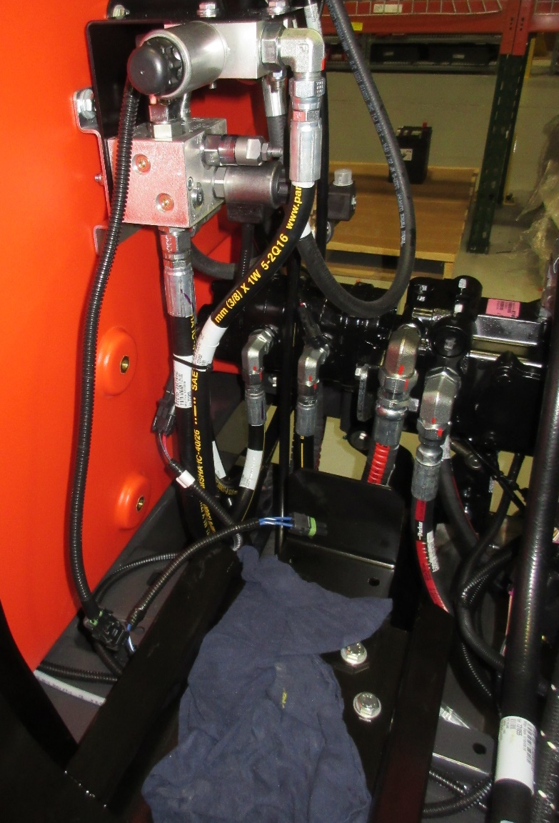
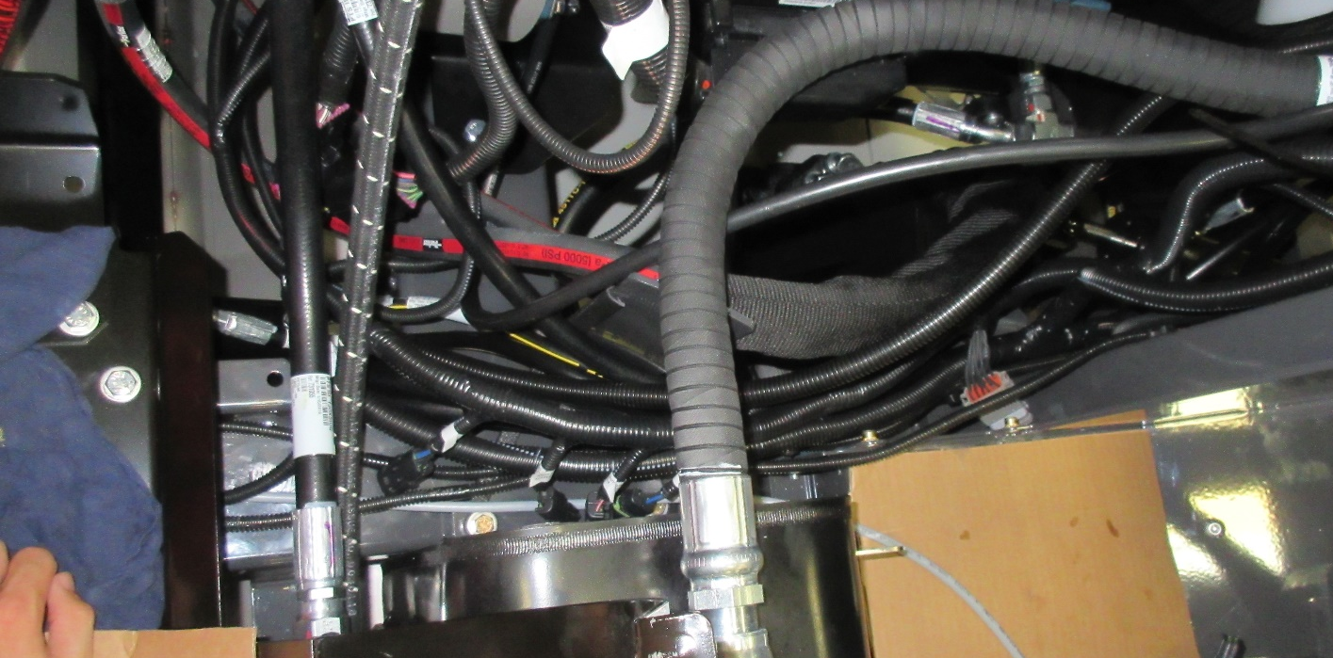

Slide 28
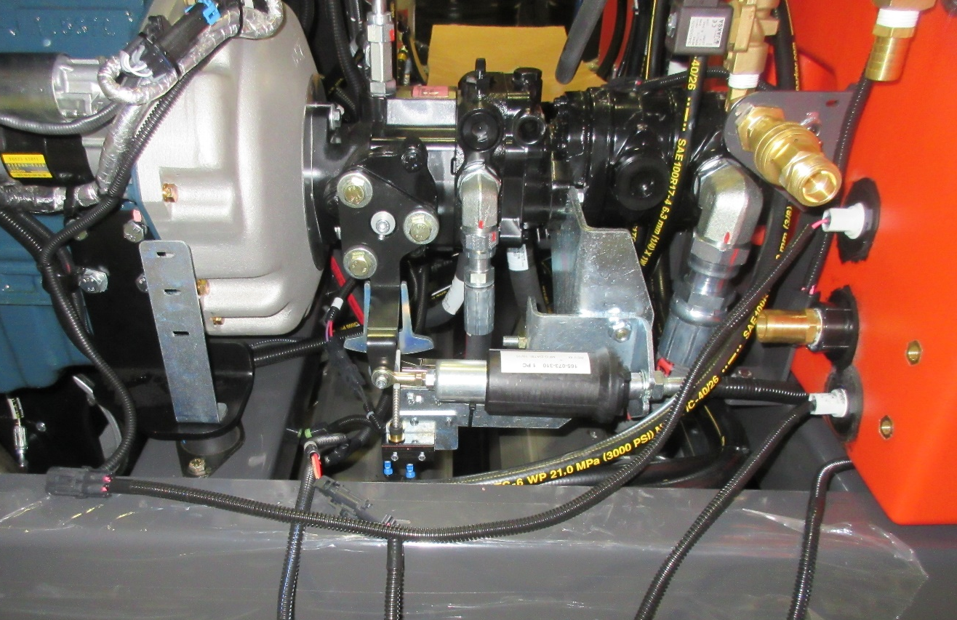
3302737-1
Route the 2 circled connectors beneath the Aux. Pump and connect them.

Slide 29
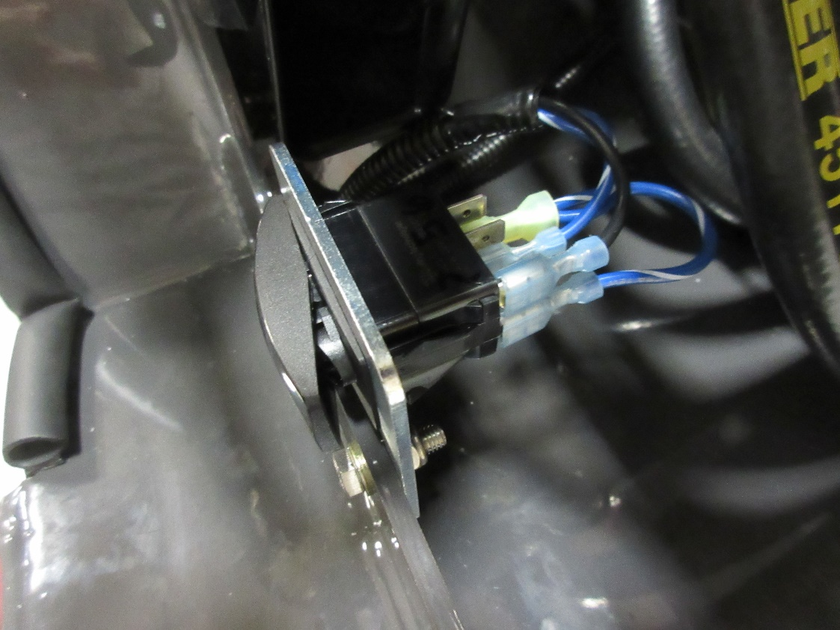
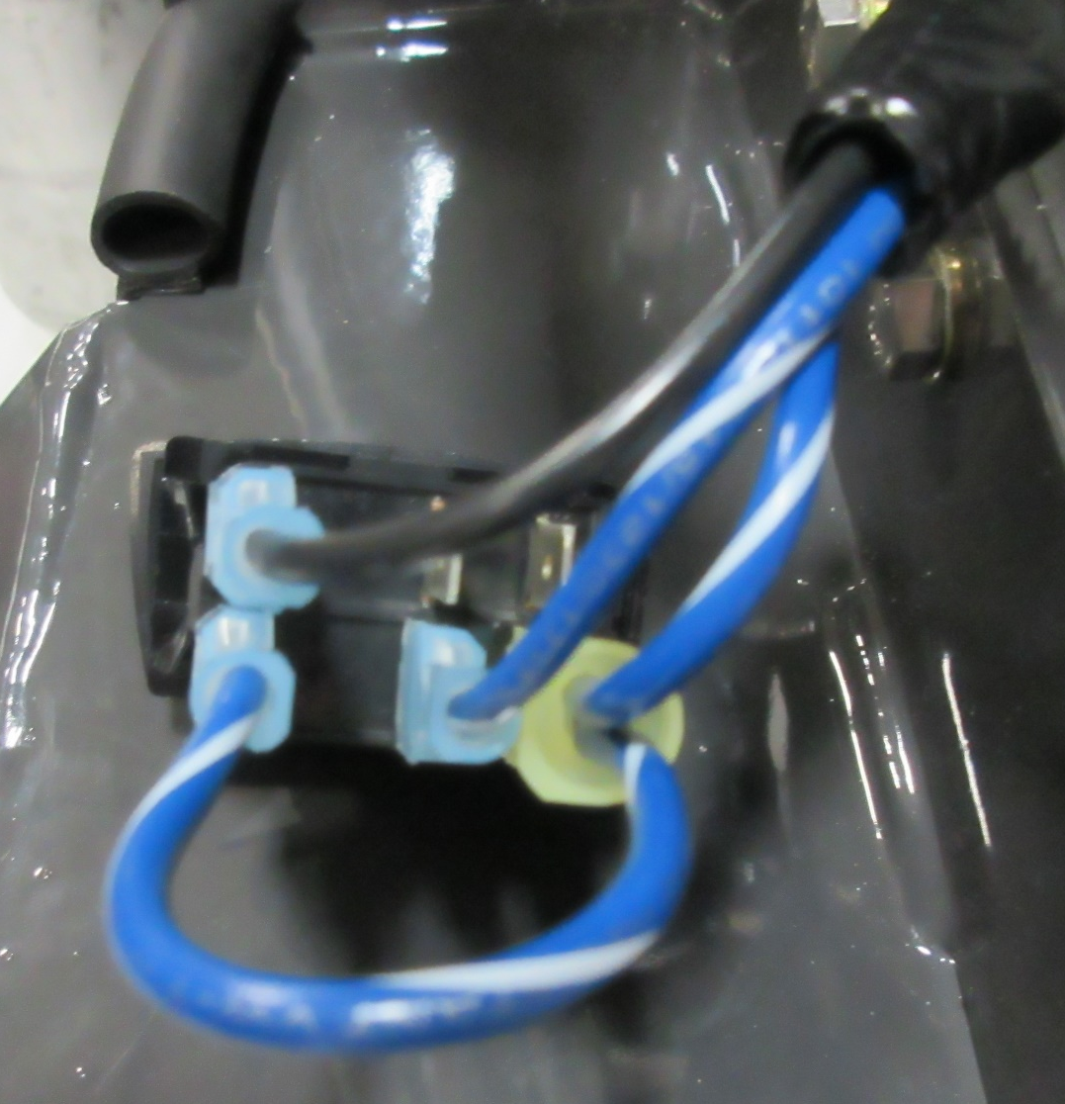
731057
TOP
Black Wire
TOP
Empty
Blue Jumper Wire
7
5
6
Double Blue Wire
8
2
3
Single Blue Wire
Connect the 748735 Wiring Harness to switch as shown.
Then route the remainder of the harness as depicted in the following pages.

Slide 30

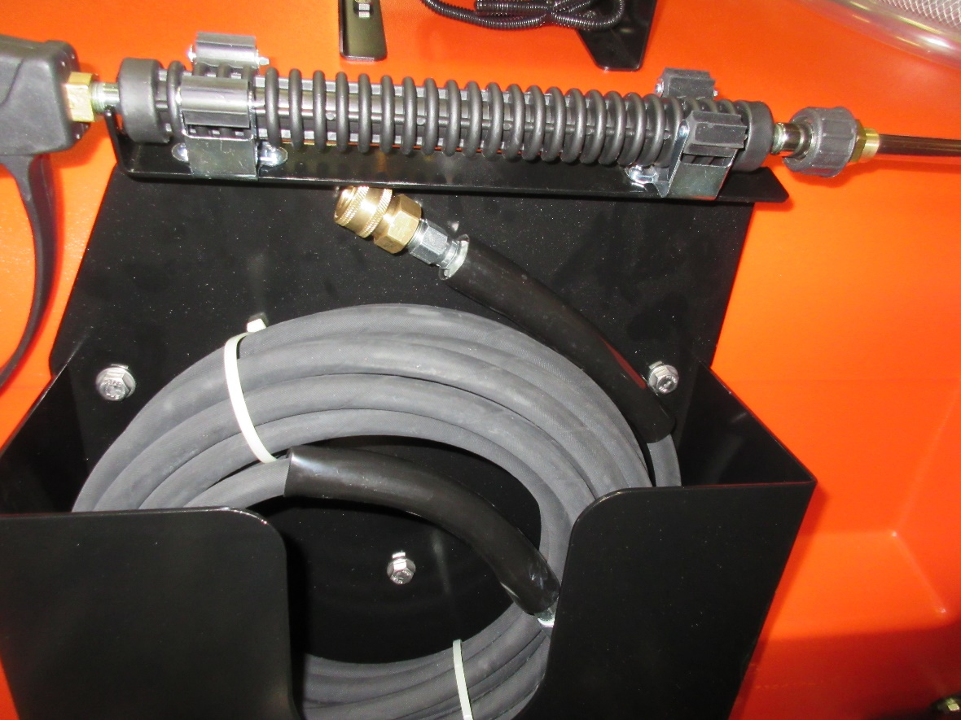
4”
3400455, 730991
4-1/2”
5-1/4”
731440
731437
Install (1) 731437 Hose Box using the measurements above.
Use (3) 3400455 Screws, and (3) 730991 Rubber Expansion Nut.
Then place (1) 731440 Hose into the 731437 Hose Box.

Slide 31
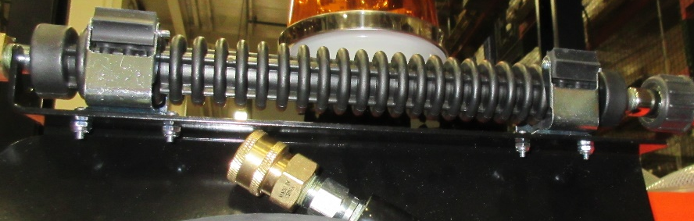
710204, 711371
00560010
731437
Install (2) 00560010 Clamps onto the 731437 Hose Box.
Use (4) 710204 Bolts, and (4) 711371 Nuts.

Slide 32
731445
731446
731447
731444
731443
Assemble (1) 731444 Gun Trigger, (1) 731445 Insulated Lane, (1) 731446 Lance, (1) 731447 Adjustable Tip, and (1) 731443 Quick Disconnect Plug.
Mount assembled parts onto the previously installed clamps.

Slide 33
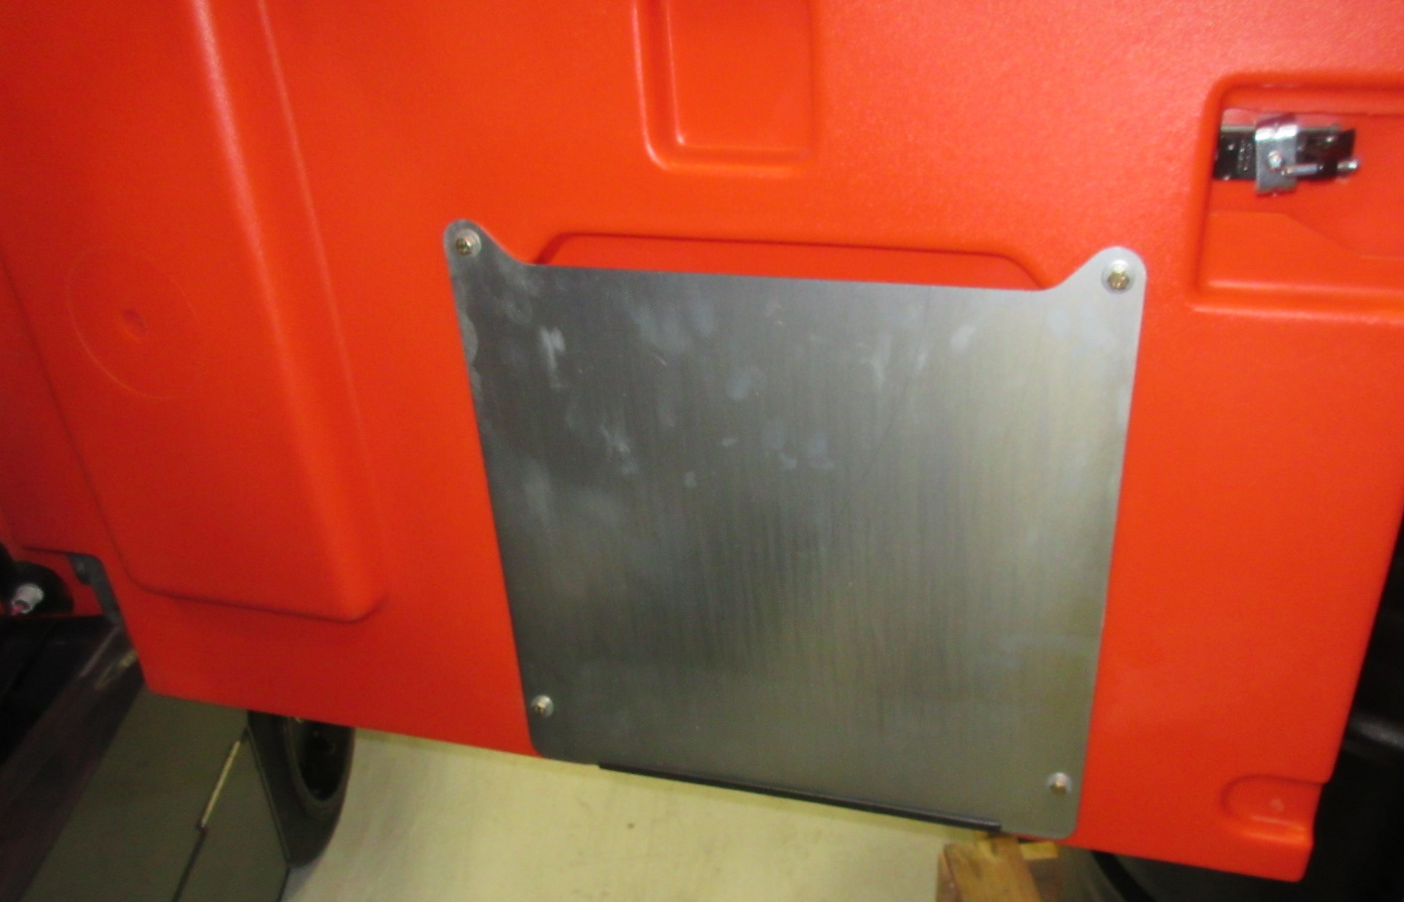
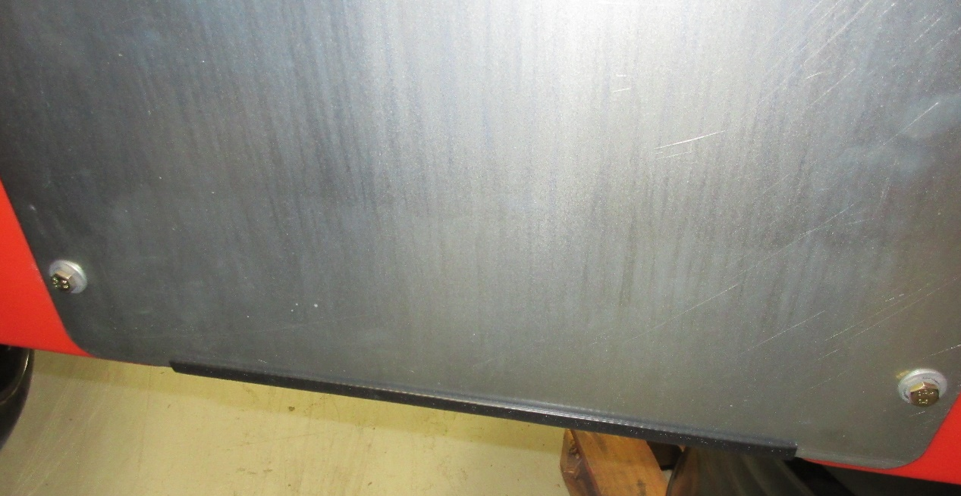
Install (12”) of 3500118 Edging onto the door of the machine.
3500118

